Slide 1

ICE 3161
COMMUNICATION ENGINEERING
(Session 2021-22)
Dr. Asif Zaman
Professor, CSE, RU
Official Starting Date: April, 2025

Slide 2
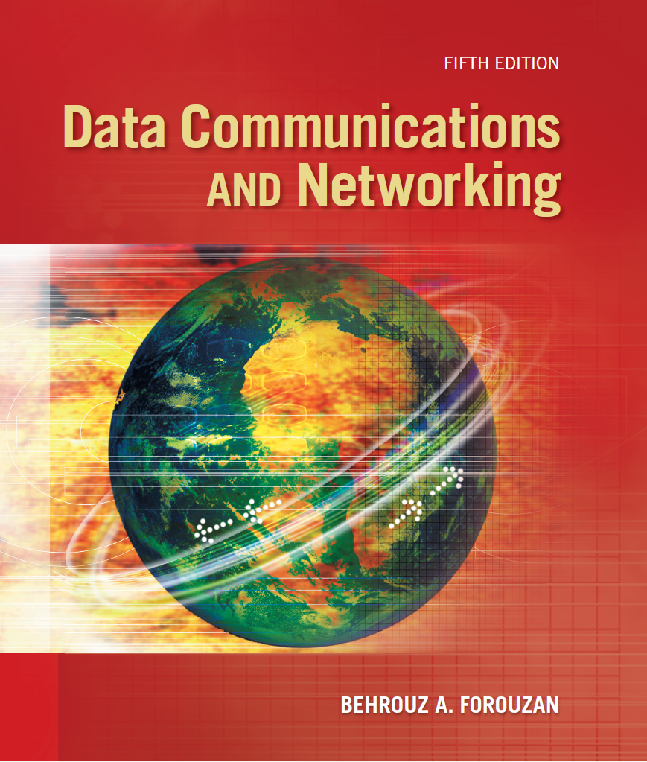
Text Books
Lesson Plan
Text book
Resources
Slides
Data Communication and Networking,
5th Edition, Behrouz A. Forouzan
https://tinyurl.com/asifzaman3180-lec

Slide 3
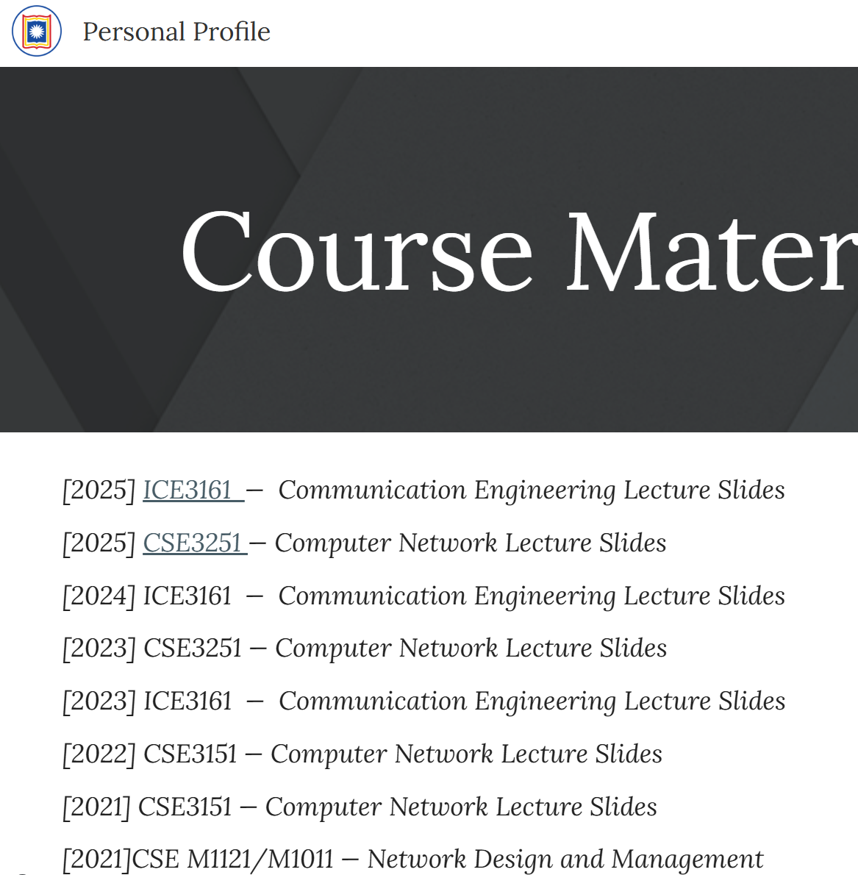
https://tinyurl.com/asifzaman3180-lec

Slide 4
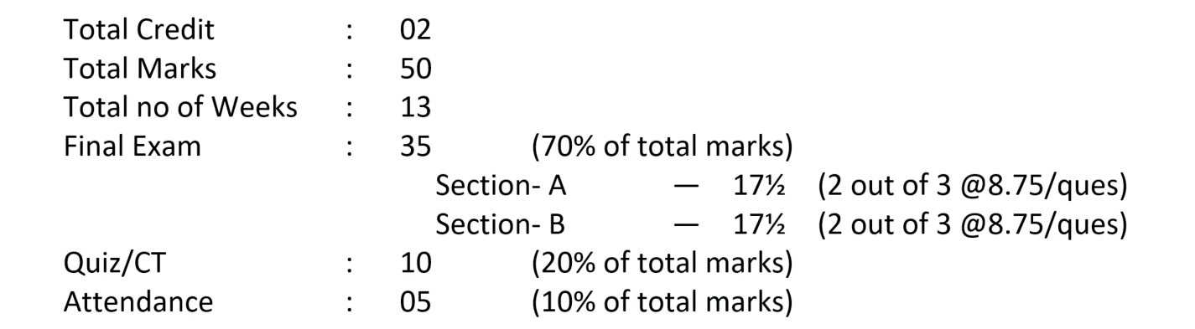
ICE3161: COMMUNICATION ENGINEERING
COMMUNICATION ENGINEERING Lab: ???

Slide 5
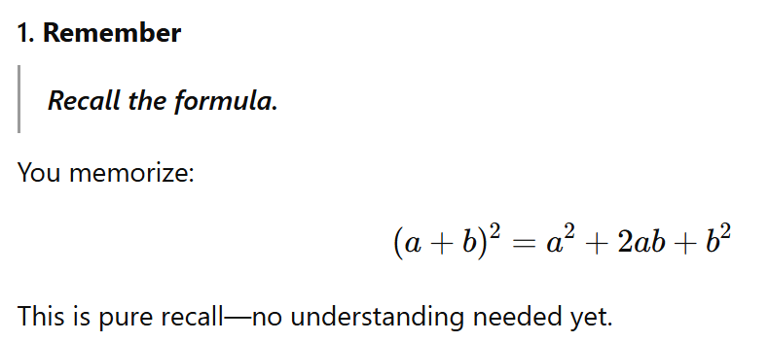
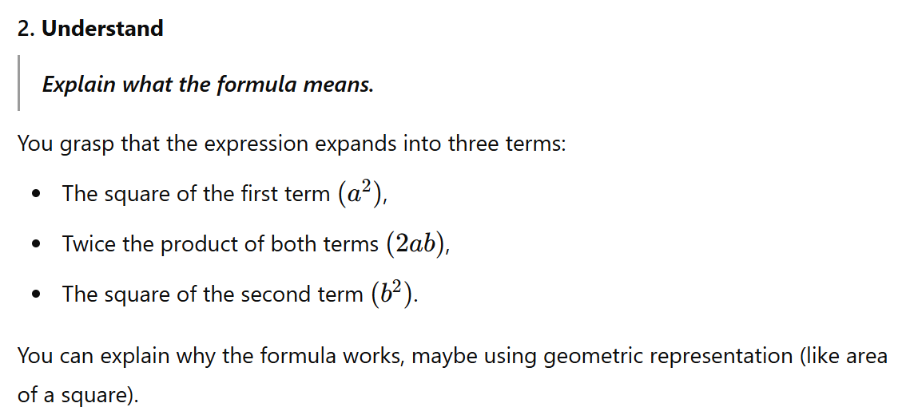
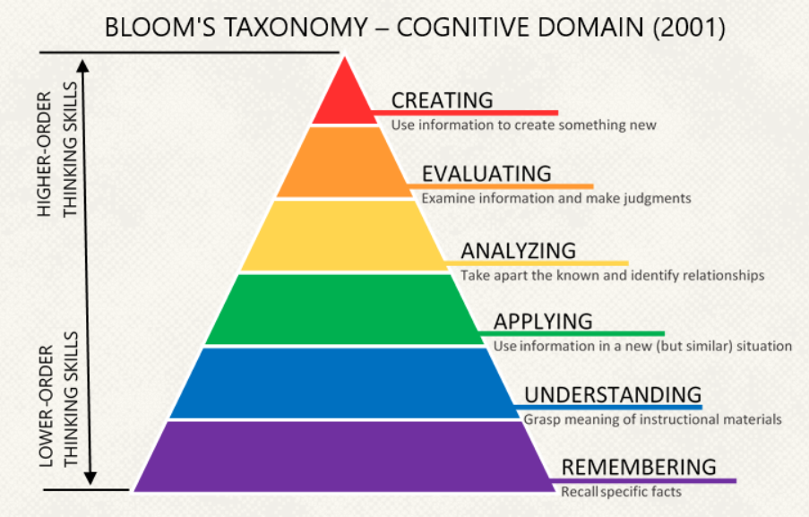
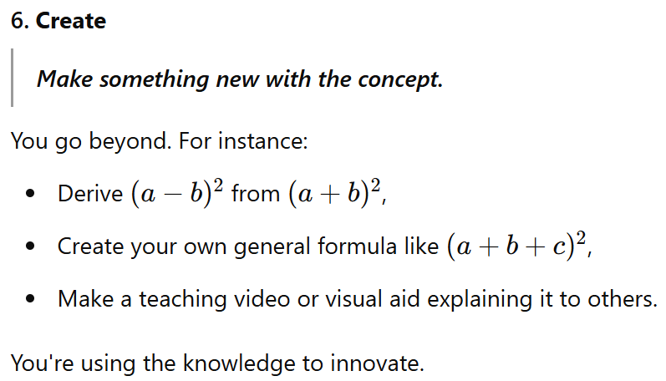
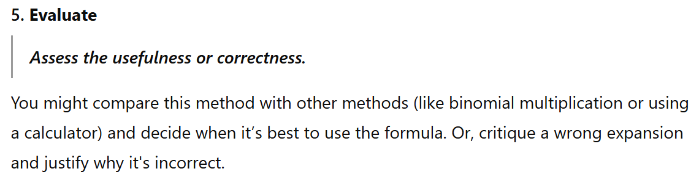
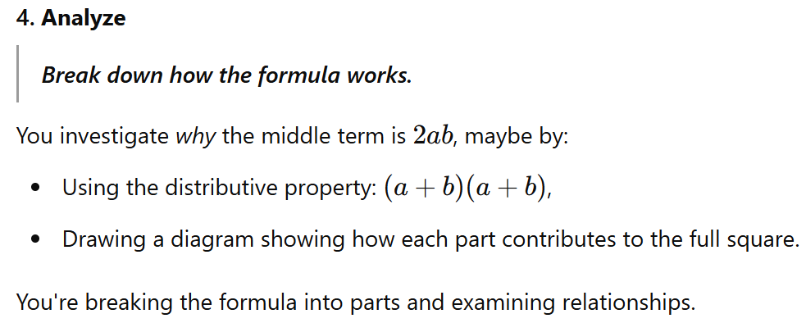
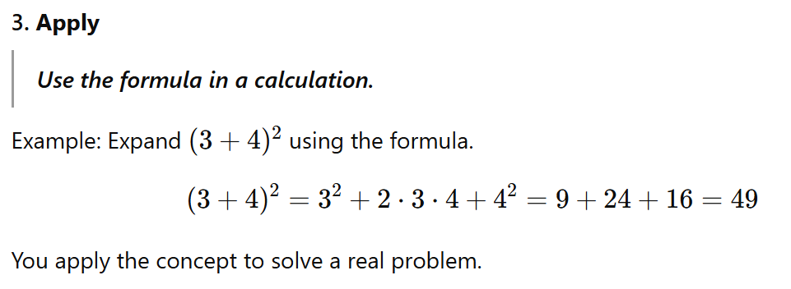

Slide 6
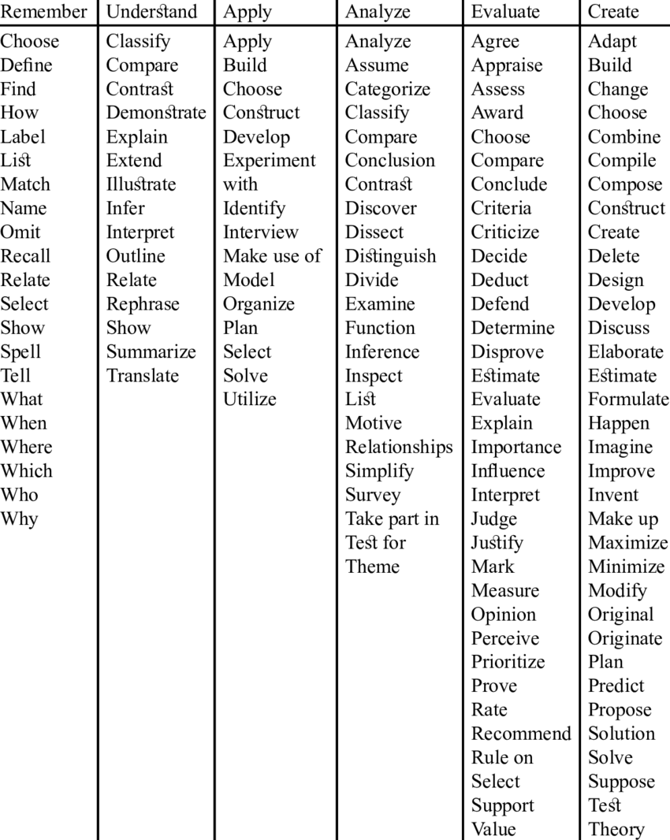

Slide 7
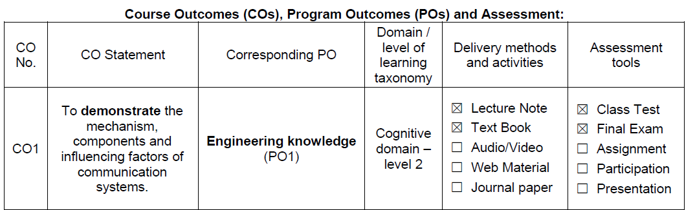
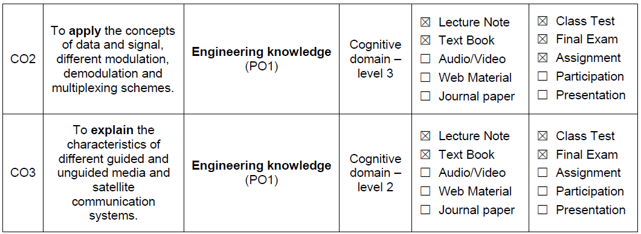

Slide 8
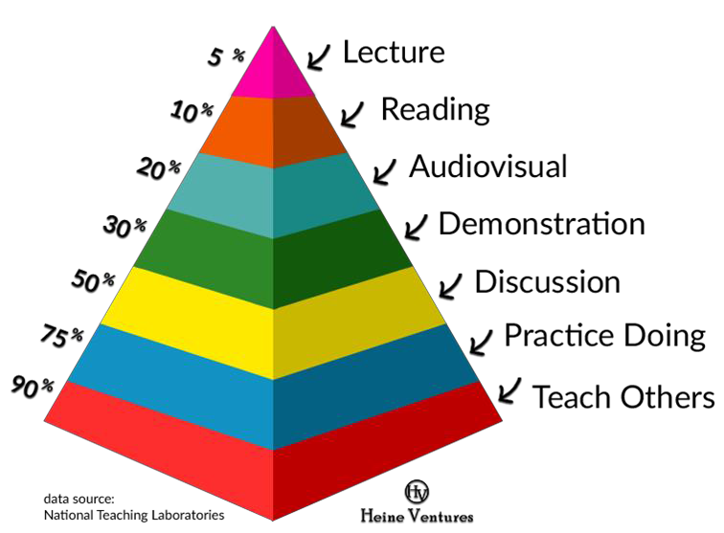
The Learning Pyramid

Slide 9
The Internet
https://www.submarinecablemap.com/

Slide 10
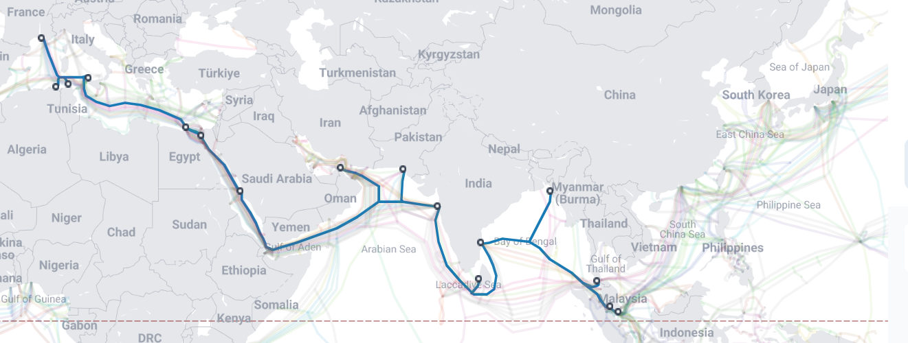
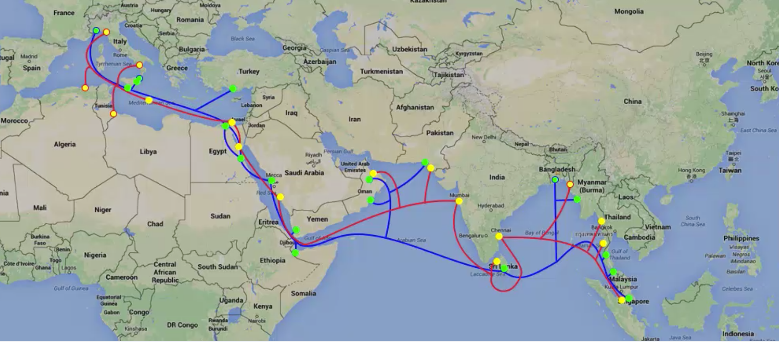
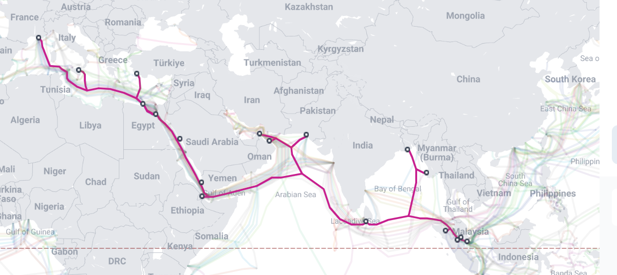
South East Asia–Middle East–Western Europe 4/5 (SEA-ME-WE 4/5)

Slide 11
Your PC/📱
Wi-Fi Router
Local ISP
National Wide Network
IPX Gateway
SEA-ME-WE 4/5
Internetwork Packet Exchange (IPX)

Slide 12
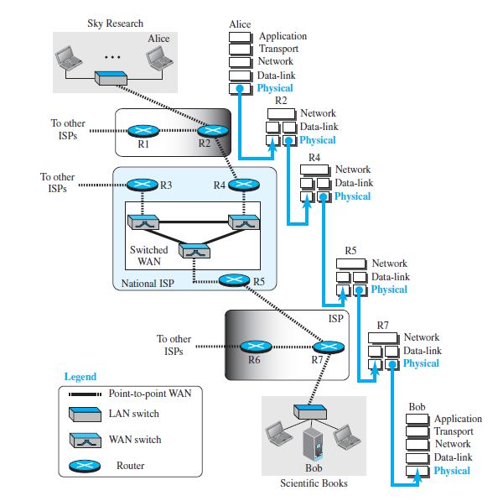

Slide 13
Data Communication
What is Data???
data is a collection of discrete or continuous values that:
convey information
describing the quantity, quality, fact, statistics, other basic units of meaning, or
simply sequences of symbols that may be further interpreted formally.

Slide 14
Data communications are
.. exchange of data between two devices
.. some form of transmission medium e.g. a wire cable.
For …., the communicating devices must
be part of a communication system :
a combination of
hardware (physical equipment) and
software (programs).
The effectiveness of a data communications system depends on four fundamental characteristics:
delivery,
accuracy,
timeliness, and
jitter.

Slide 15
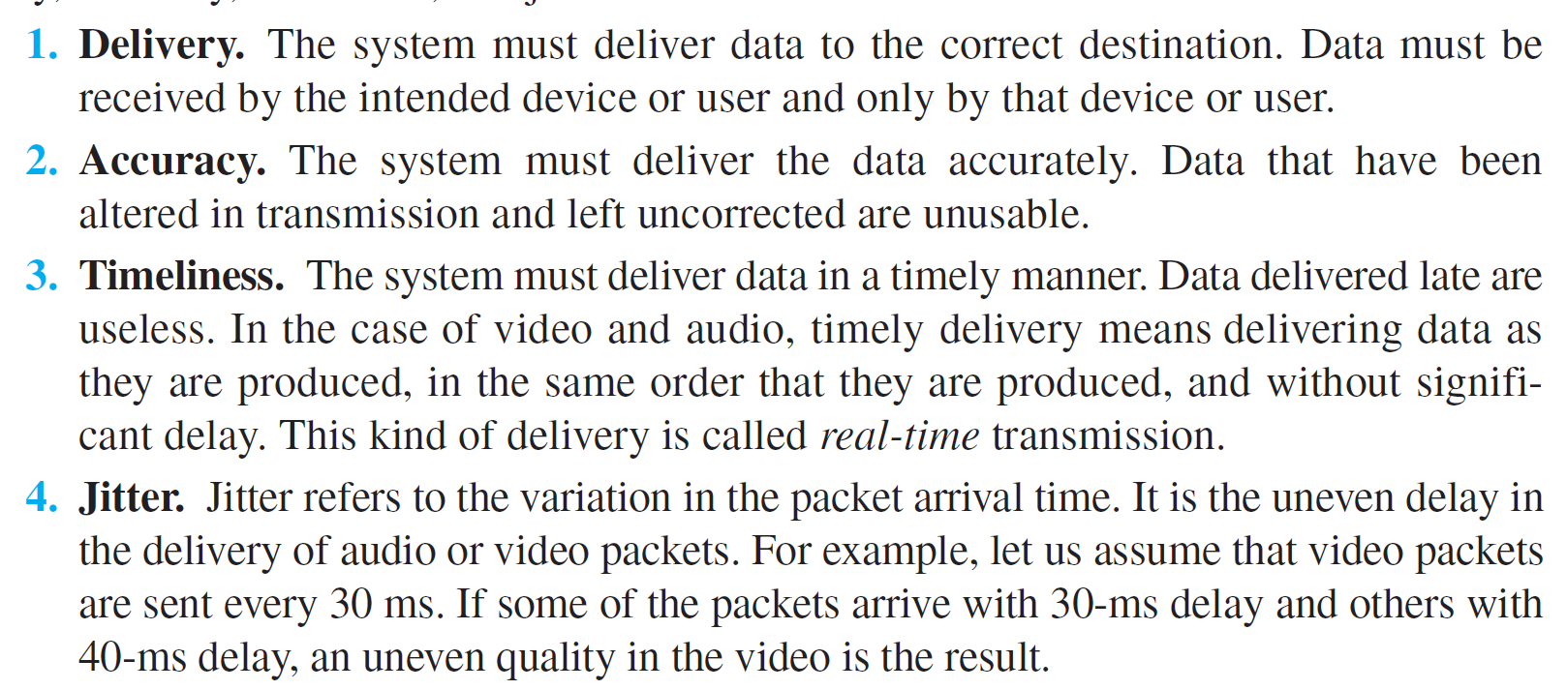
fundamental characteristics

Slide 16
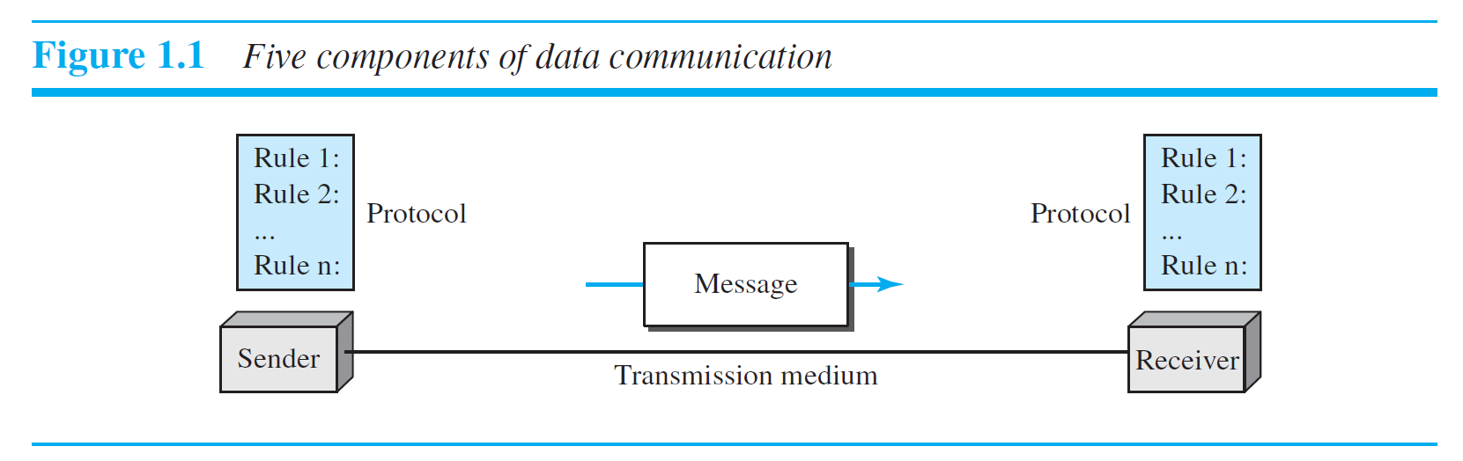
Components of Data Communication
Transmission medium. The transmission medium is the physical path by which a message travels from sender to receiver. Some examples of transmission media
include twisted-pair wire, coaxial cable, fiber-optic cable, and radio waves.
Receiver. The receiver is the device that receives the message. It can be a computer,
workstation, telephone handset, television, and so on.
Protocol. A protocol is a set of rules that govern data communications.
It represents an agreement between the communicating devices.
Without a protocol, two devices may be connected but not communicating,
Sender. The sender is the device that sends the data message. It can be a computer,
workstation, telephone handset, video camera, and so on.
Message. The message is the information (data) to be communicated. Popular
forms of information include text, numbers, pictures, audio, and video.
Message.
Sender
Receiver
Transmission medium
Protocol

Slide 17
Data Representation
…text is represented as a bit pattern, a sequence of bits (0s or 1s).
Different sets of bit patterns have been designed to represent text symbols. - called a code,
and the process of representing symbols ̶ coding.
Unicode, which uses 32 bits to represent a symbol or character used in any language in the world.
The American Standard Code for Information Interchange (ASCII), developed some decades ago in the United States,
Text
Numbers
Images
audio
video.

Slide 18
Data Representation
Text
Numbers
Images
audio
video.
Numbers are also represented by bit patterns.
… a code such as ASCII is not used
To represent numbers; the number is directly converted to a binary number to simplify
…mathematical operations.

Slide 19
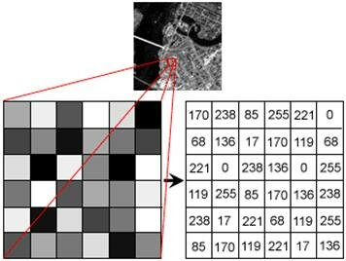
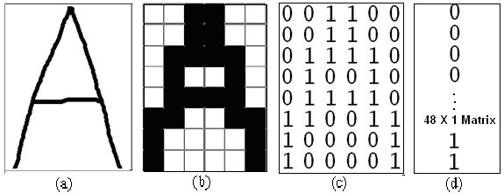
Data Representation
Images are also represented by bit patterns.
…an image is composed of a matrix of pixels (picture elements), where each pixel is a small dot. …
There are several methods to represent color images. One method is called RGB, so called because each color is made of a combination of three primary colors: red, green, and blue.
The intensity of each color is measured, and a bit pattern is assigned to it. Another method is called YCM, in which a color is made of a combination of three other primary colors: yellow, cyan, and magenta.
Text
Numbers
Images
audio
video.

Slide 20
Data Representation
Audio refers to the recording or broadcasting of sound or music.
Audio is by nature different from text, numbers, or images. It is continuous, not discrete.
Even when we use a microphone to change voice or music to an electric signal, we create a continuous signal.
Text
Numbers
Images
audio
video.

Slide 21
Data Representation
Video refers to the recording or broadcasting of a picture or movie.
Video can either be produced as a continuous entity (e.g., by a TV camera), or it can be a combination of images, each a discrete entity, arranged to convey the idea of motion.
Text
Numbers
Images
audio
video.

Slide 22
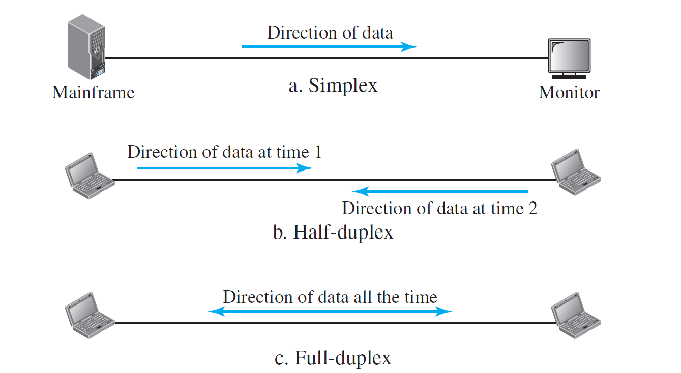
Data Flow

Slide 23
Network
NETWORKS: ??
A network is the interconnection of a set of devices capable of communication.
a device can be a host: end system such as a large computer, desktop, laptop, workstation, cellular phone, or security system
A device ….connecting device such as a router/ switch
…wired or wireless transmission media such

Slide 24
Network Criteria
A network must be able to meet a certain number of criteria.
The most important of these are:
Performance,
Reliability,
and Security.

Slide 25
Network Criteria: Performance
Performance …transit time and response time.
Transit time is the amount of time required for a message to travel from one device to another.
Response time is the elapsed time between an inquiry and a response.
…factors:
the number of users,
the type of transmission medium,
the capabilities of the connected hardware,
and the efficiency of the software

Slide 26
Network Criteria: Performance
Performance is often evaluated by two networking metrics:
throughput and
delay.
We often need more throughput and less delay.
If we try to send more data to the network, we may increase throughput but we increase the delay because of traffic congestion in the network.

Slide 27
Network Criteria: Reliability
Reliability
accuracy of delivery +
frequency of failure,
the time it takes a link to recover from a failure
the network’s robustness (শক্তি) in a catastrophe (disaster).

Slide 28
Network Criteria: Security
Network security issues include:
Protecting data from unauthorized access
Protecting data from damage and
Development & implementing policies and procedures for recovery from breaches and data losses.

Slide 29
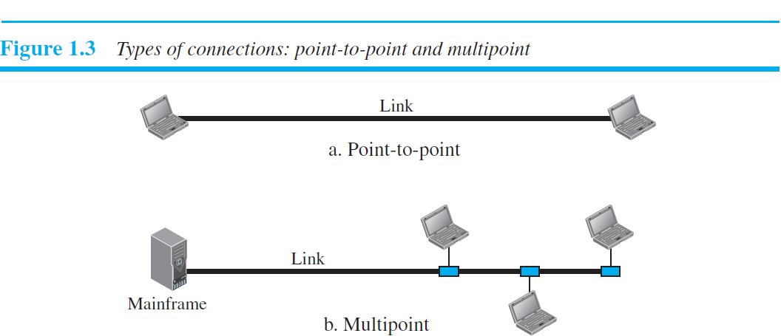
Network Physical Structures
Physical Structures - attributes
Type of Connection
Physical Topology

Slide 30
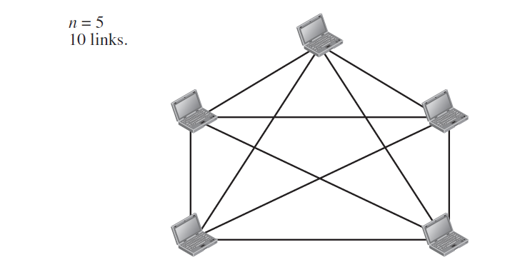
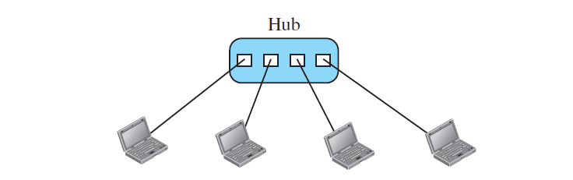
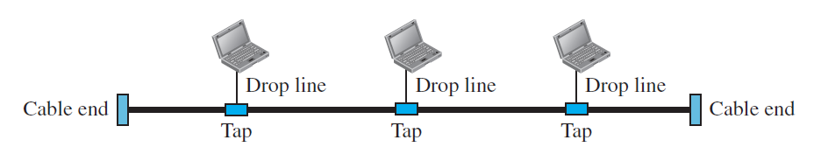
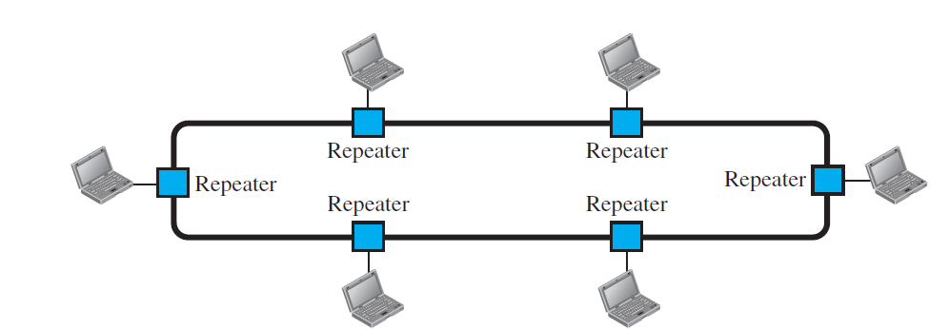
Physical Topology: … refers to the way in which a network is laid out physically.
Mesh Topology
Star Topology
Bus Topology
Ring Topology

